Slide 1

Health for All, Insights from Leaders: a reflection session on the World Health Organization’s efforts

Slide 2
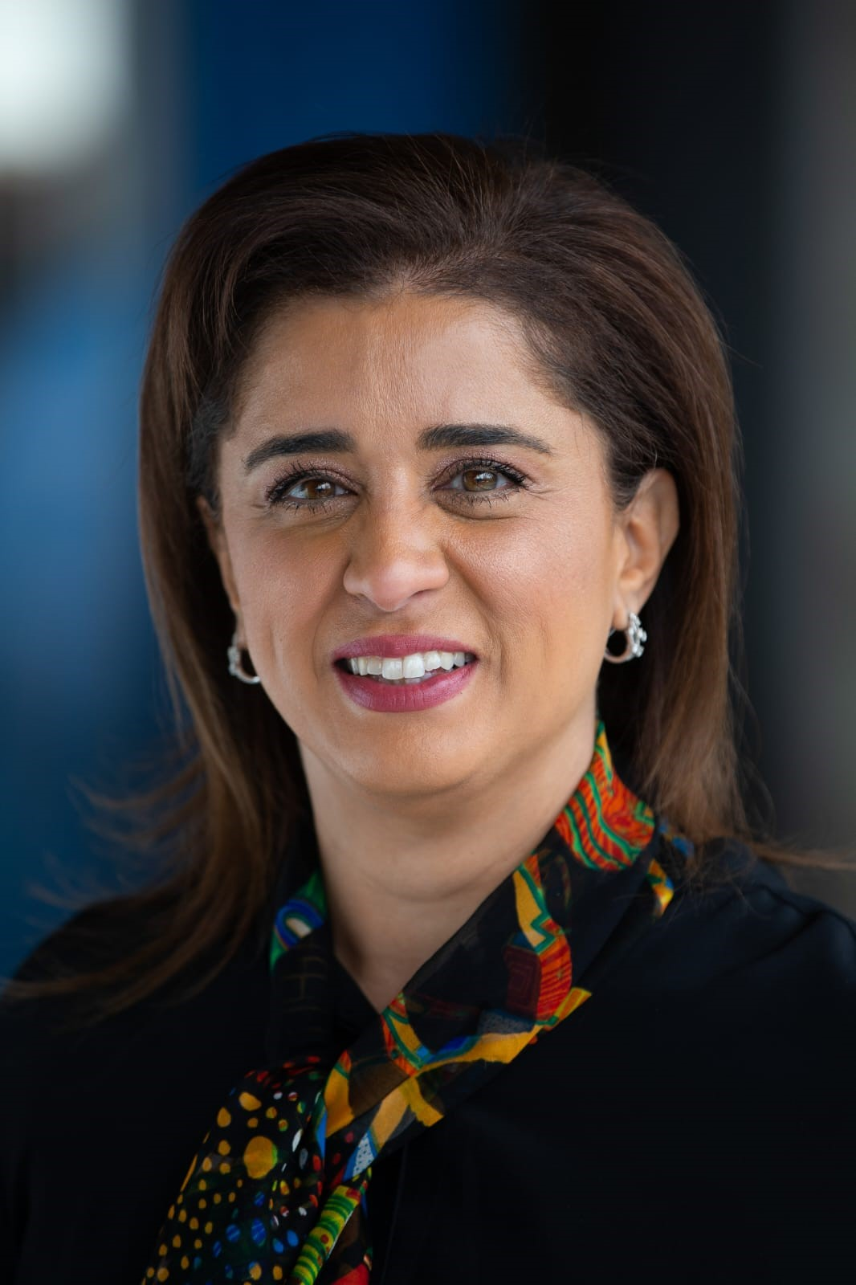
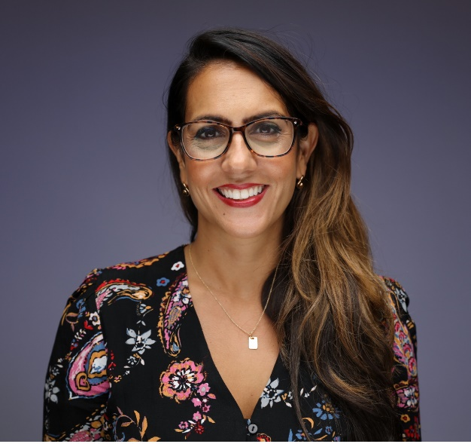
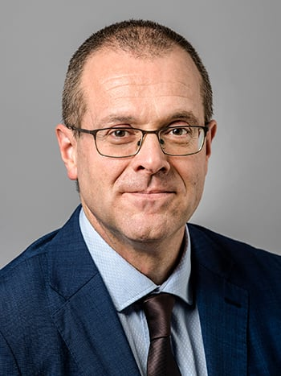
Dr. Hanan Balkhy
Regional Director Elect for Eastern Mediterranean Region, World Health Organization (WHO
Dr Dominique Allwood
IHI Faculty,
Director of Population Health, Imperial College Healthcare NHS Trust (UK)
Dr. Hans Kluge
WHO Regional Director for Europe

