Slide 1

Global Health Resilience: Navigating Crisis with Quality Improvement and Patient Safety

Slide 2
Disclosure Statement
I make the following declaration in relation to this presentation:
There is NO Conflict of Interest
There is no bias, either commercial or non-commercial
There is no plagiarism or copyright infringement

Slide 3
Learning Objectives
At the end of this session, participants will be able to:
Understanding Crisis Challenges: Participants will gain a deeper understanding of the unique challenges in providing healthcare during crises and conflicts
Insights from different panelists: Attendees will learn from the experiences and strategies of all engaged parties in handling health crises, with focus on QI and PS
Emergency Response Techniques: To acquire skills and knowledge in resilient emergency response techniques and crisis management in healthcare
Policy Development Skills: Participants will learn how to develop and implement policies that ensure efficient healthcare delivery during emergencies
Networking and Collaboration: Attendees will have the opportunity to network with peers and experts, fostering collaborations for future crisis response initiatives

Slide 4
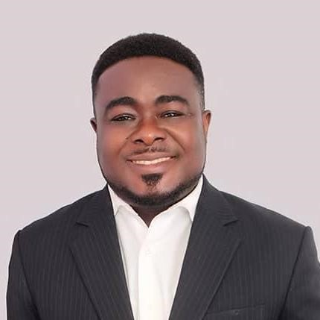
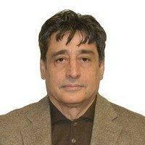
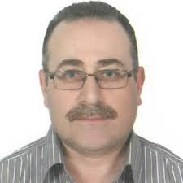
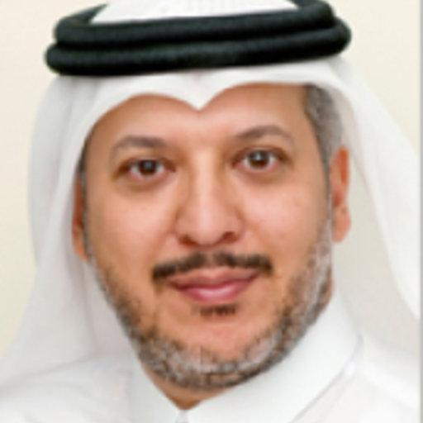
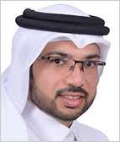
Dr. Abdul Salam AlQahtani
Chair of Medical Committee in QRCS
Prof Aftab Mohammad Umar
Chair Emergency Medicine & Chair Gaza Patient Transport Committee
Sodzi Sodzi-Tettey
Vice President Global Delivery, IHI
Dr. Mondher Letaief, Regional Advisor on Quality & Safety, WHO EMRO
Dr. Mohamed Alabiad, Deputy Medical Director, QRC and Quality & Safety Expert

