Slide 1

Community Healthcare Perspectives – a panel discussion

Slide 2
Disclosure Statement
I make the following declaration in relation to this presentation:
There is NO Conflict of Interest
There is no bias, either commercial or non-commercial
There is no plagiarism or copyright infringement

Slide 3
Learning Objectives
1. Increased awareness of the challenges and opportunities for delivering community health improvement
2. Actionable insights to drive positive change and enhance healthcare delivery in the community
Notes:
In this session participants will hear diverse perspectives from a range of leaders and practitioners, to gain a deeper understanding of the challenges and opportunities for delivering community health improvement. Through this panel discussion, attendees will be equipped with actionable insights to drive positive change and enhance healthcare delivery in the community.

Slide 4
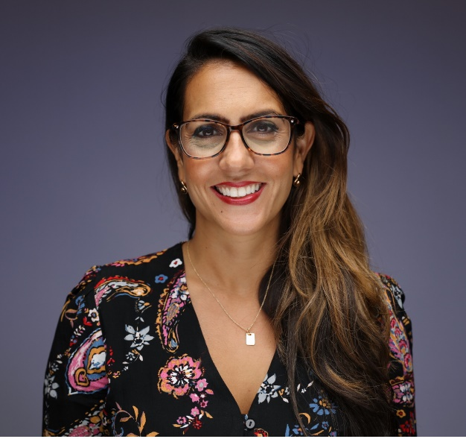
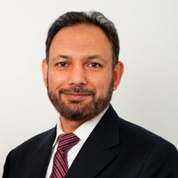
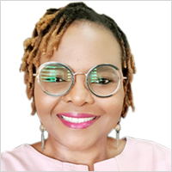
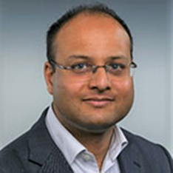
Dr Dominique Allwood
IHI Faculty,
Director of Population Health, Imperial College Healthcare NHS Trust (UK)
Prof Mahmood Adil
Ministerial Advisor,
Ministry of Public Health
(Qatar)
Senior Director, Institute for Healthcare Improvement (IHI)
National Clinical Director for NHS Improvement, NHS England
Chief Quality Officer, East London Foundation Trust (UK)

Slide 5
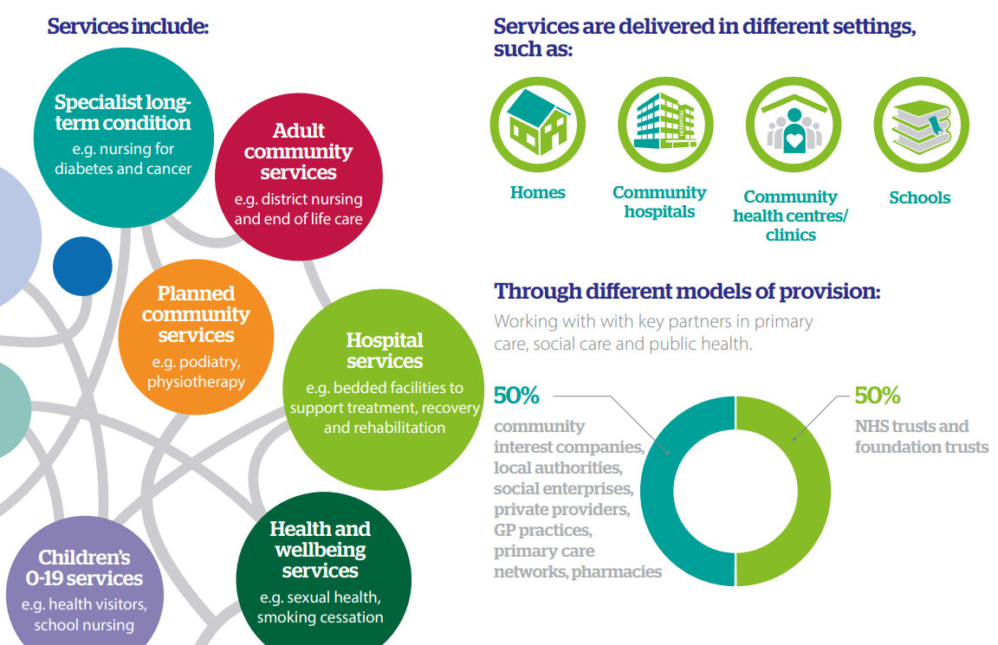
https://www.nhsconfed.org/system/files/2021-06/What-are-community-health-services-infographic.pdf

